Slide 1
Address Space Management
Transitioning to IPv6

Slide 2
Why Do We Need a Larger
Address Space?
  Internet population
    Approximately 973 million users in November 2005
    Emerging population and geopolitical address space
  Mobile users
    PDA, pen tablet, notepad, and so on
    Approximately 20 million in 2004
  Mobile phones
    Already 1 billion mobile phones delivered by the industry
  Transportation
    1 billion automobiles forecast for 2008
    Internet access in planes, for example, Lufthansa
  Consumer devices
    Sony mandated that all its products be IPv6-enabled by 2005
    Billions of home and industrial appliances

Slide 3
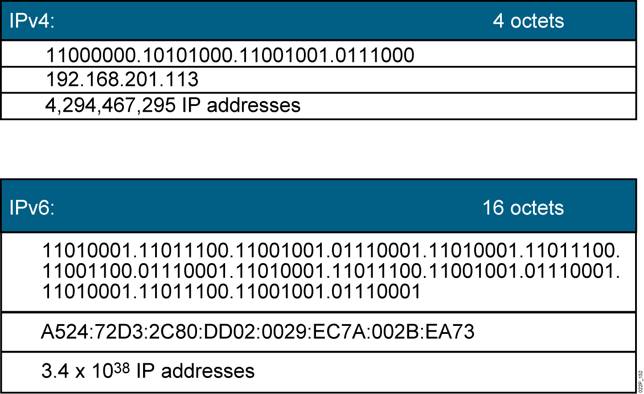
IPv4 and IPv6
Currently, there are approximately 1.3 billion usable IPv4 addresses
available.
Notes:
Lesson Aim
<Enter lesson aim here.>

Slide 4
IPv6 Advanced Features
Larger address space:
  Global reachability and flexibility
  Autoconfiguration
  Plug-and-play
  End-to-end without NAT
Simpler header:
  Routing efficiency
  Performance and forwarding rate scalability
  No broadcasts
  Extension headers
Transition richness:
  Dual stack
  6to4 and manual tunnels
  Translation

Slide 5
IPv6 Address Representation
Format:
  x:x:x:x:x:x:x:x, where x is a 16-bit hexadecimal field
    Case-insensitive for hexadecimal A, B, C, D, E, and F
  Leading zeros in a field are optional
  Successive fields of zeros can be represented as :: only once per address
Examples:
  2031:0000:130F:0000:0000:09C0:876A:130B
    Can be represented as 2031:0:130f::9c0:876a:130b
    Cannot be represented as 2031::130f::9c0:876a:130b
  FF01:0:0:0:0:0:0:1 FF01::1
  0:0:0:0:0:0:0:1 ::1
  0:0:0:0:0:0:0:0 ::
Notes:
128 bit-> 32 hexa number. Slipt into 8 field

Slide 6
IPv6 Address Types
  Unicast:
    Address is for a single interface
    IPv6 has several types (for example, global, reserved, link-local, and site-local)
  Multicast:
    One-to-many
    Enables more efficient use of the network
    Uses a larger address range
  Anycast:
    One-to-nearest (allocated from unicast address space)
    Multiple devices share the same address
    All anycast nodes should provide uniform service
    Source devices send packets to anycast address
    Routers decide on closest device to reach that destination
    Suitable for load balancing and content delivery services

Slide 7
IPv6 Unicast Addressing
  Types of IPv6 unicast addresses:
    Global: Starts with 2000::/3 and assigned by IANA
    Link local: starts with FE80::/10)
    Site Local / Unique – local Unicast
    Loopback (::1)
    Unspecified (::)
  A single interface may be assigned multiple IPv6 addresses of any type: unicast, anycast, or multicast.

Slide 8
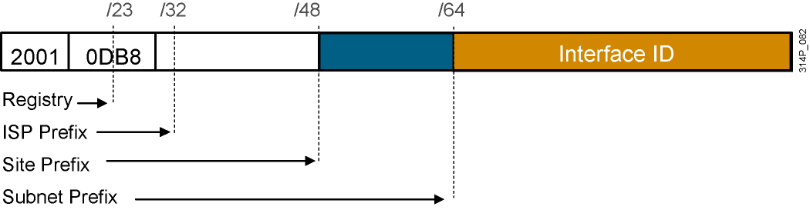
IPv6 Global Unicast (and Anycast)
Addresses
IPv6 has the same address format for global unicast and for
anycast addresses.
  Uses a global routing prefix—a structure that enables aggregation upward,
  eventually to the ISP.
  Global unicast start with 3 bit 001-> 2000::/3
  Every IPv6-enabled interface contains at least one loopback (::1/128)
  and one link-local address.
  Optionally, every interface can have multiple unique local and global addresses.

Slide 9
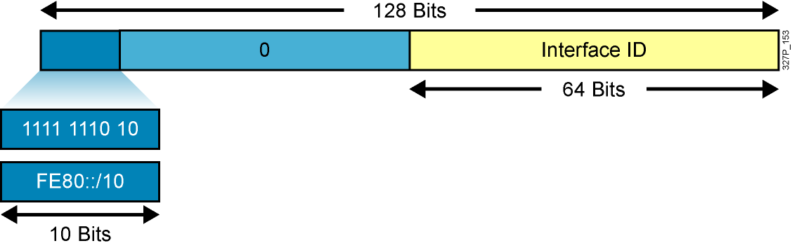
Link-Local Addresses
Link-local addresses have a scope limited to the link and are dynamically
created on all IPv6 interfaces by using a specific link-local prefix FE80::/10
and a 64-bit interface identifier.
Link-local addresses are used for automatic address configuration, neighbor
discovery, and router discovery. Link-local addresses are also used by many
routing protocols.
When communicating with a link-local address, you must specify the outgoing
interface because every interface is connected to FE80::/10.

Slide 10
Unique – local Unicast
Same as the Private IP v4 Address
Start with FC00::/7
Before Unique, it is site local and start with FEC0::/10
Unique is instead of site local

Slide 11
Multicast
FF00::/8 is the same with class D in IPv4
Address | Used
FF02::1 | All hosts on the Link
FF02::2 | All Routers on the Link
FF02::5, FF02::6 | OSPFv3
FF02::9 | RIPng
FF02::A | EIGRPv6

Slide 12
Assigning IPv6 Global Unicast Addresses
  Static assignment
    Manual interface ID assignment
    EUI-64 interface ID assignment
  Dynamic assignment
    Stateless autoconfiguration
    DHCPv6 (stateful)

Slide 13
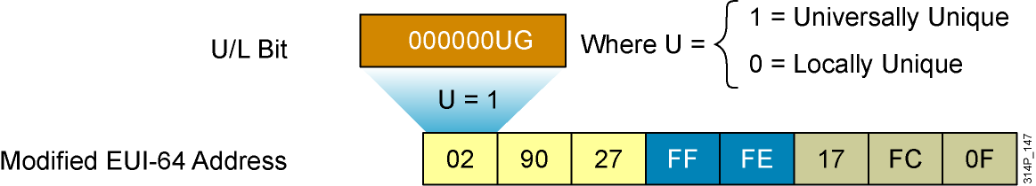
IPv6 EUI-64 Interface Identifier
Cisco can use the EUI-64 format for interface identifiers.
This format expands the 48-bit MAC address to 64 bits by inserting “FFFE” into the middle 16 bits.
To make sure that the chosen address is from a unique Ethernet MAC address, the U/L bit is set to 1 for global scope (0 for local scope).
Notes:
EUI-64 to IPv6 Interface Identifier
The interface identifier for stateless auto-configuration in an Ethernet environment uses the modified EUI-64 format. This format expands the 48-bit Ethernet MAC address format to a 64-bit version by inserting "FFFE" in the middle of the 48 bits. This creates a 64-bit version.
The 7th bit (starting with the leftmost bit as “1”) in an IPv6 interface identifier is referred to as the Universal/Local bit, or U/L bit. This bit identifies whether this interface identifier is locally unique on the link or that it is universally unique. In the case where the interface identifier is created from an Ethernet MAC address, it is assumed that the MAC address is universally unique and, therefore, the interface identifier is universally unique.
The rationale of the U/L bit is for future use of the upper-layer protocols to uniquely identify a connection, even in the context of a change in the leftmost part of the address. However, this is not yet used.
The 8th bit (starting with leftmost bit as “1”), also known as the “G” bit, is a group/individual bit for managing groups.
Note to Graphic Designer:
Animation is needed for this slide.
Stage 1: Show Ethernet MAC address (top address on slide) and two FF and FE blocks.
Stage 2: Show the FF and FE blocks going in-between blocks 27 and 17 of Ethernet address. Change label of address to Ethernet MAC address (64 bits). Also Show the U/L bit coming out of the OO block with the where U = information.
Stage 3: Show final Modified EUI-64 address.
Instructor Note
Discuss the transformative process for EUI-64 to IPv6 interface identifier.

Slide 14
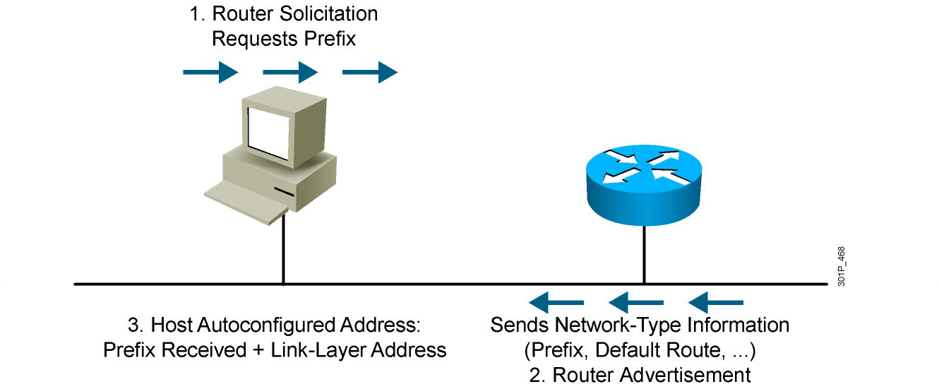
Stateless Autoconfiguration

Slide 15
DHCPv6 (Stateful)
DHCPv6 is an updated version of DHCP for IPv4:
  Supports new addressing
  Enables more control than stateless autoconfiguration
  Can be used for renumbering
  Can be used for automatic domain name registration of hosts using dynamic DNS
Notes:
DHCPv6 (Dynamic Host Configuration Protocol) is an updated version of DHCP for IPv4. It supports the addressing model of IPv6 and benefits from new IPv6 features. DHCPv6:
Enables more control than serverless/stateless auto-configuration.
Can be used in a routerless environment using only servers.
Can also be used concurrently with stateless auto-configuration.
Can be used for renumbering.
Can be used for automatic domain name registration of hosts using dynamic DNS.

Slide 16
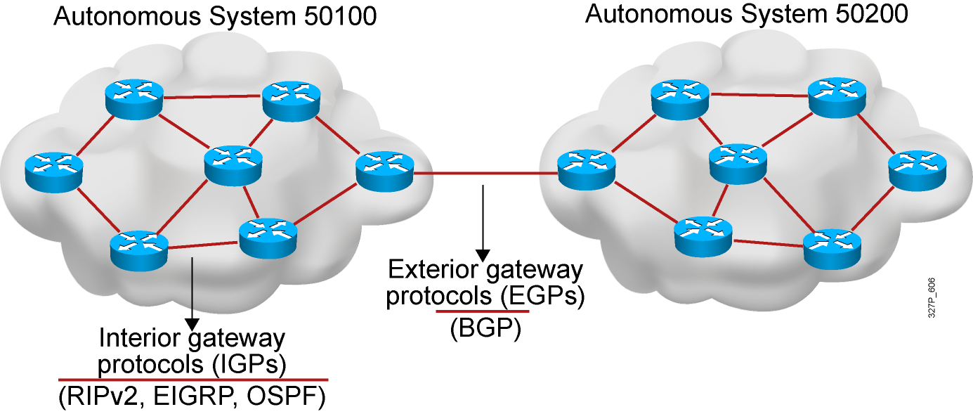
IPv6 Routing Protocols
  IPv6 routing types:
    Static
    RIPng (RFC 2080)
    OSPFv3 (RFC 2740)
    IS-IS for IPv6
    MP-BGP4 (RFC 2545/2858)
    EIGRP for IPv6
  The ipv6 unicast-routing command is required to enable
  IPv6 before any routing protocol is configured.

Slide 17
RIPng (RFC 2080)
Similar IPv4 features:
  Distance vector, radius of 15 hops, split horizon, and poison reverse
  Based on RIPv2
Updated features for IPv6:
  IPv6 prefix, next-hop IPv6 address
  Uses the multicast group FF02::9, the all-rip-routers multicast group, as the destination address for RIP updates
  Uses IPv6 for transport
  Named RIPng

Slide 18
OSPF Version 3 (OSPFv3) (RFC 2740)
Similar to IPv4
  Same mechanisms, but a major rewrite of the internals of the protocol
Updated features for IPv6
  Every IPv4-specific semantic removed
  Carry IPv6 addresses
  Link-local addresses used as source
  IPv6 transport
  OSPF for IPv6 currently an IETF proposed standard
Notes:
Cisco IOS does not support OSPF for IPv6 yet.

Slide 19
OSPFv3 Differences from OSPFv2
OSPFv3 protocol processing is per link, not per subnet
  IPv6 connects interfaces to links.
  Multiple IPv6 subnets can be assigned to a single link.
  Two nodes can talk directly over a single link, even though they do not share a common subnet.
  The terms “network” and “subnet” are being replaced with “link.”
  An OSPF interface now connects to a link instead of to a subnet.

Slide 20
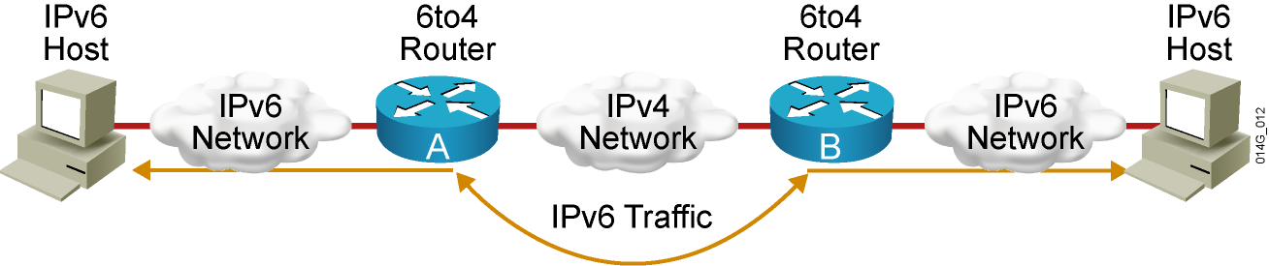
IPv4-to-IPv6 Transition
Transition richness means:
    No fixed day to convert; no need to convert all at once
    Different transition mechanisms are available:
      Dual stack
      Manual tunnel
      6to4 tunnel
      ISATAP tunnel
      Teredo tunnel
    Different compatibility mechanisms:
      Proxying and translation (NAT-PT)

Slide 21
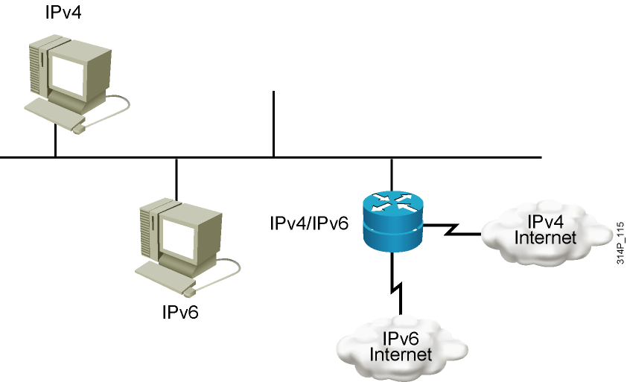
Cisco IOS Dual Stack
Dual stack is an integration method in which a node has implementation and connectivity to both an IPv4 and IPv6 network.

Slide 22
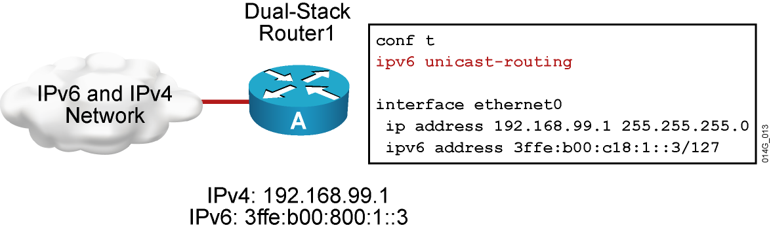
Cisco IOS Dual Stack (Cont.)
When both IPv4 and IPv6 are configured on an interface, the interface is considered dual-stacked.

Slide 23
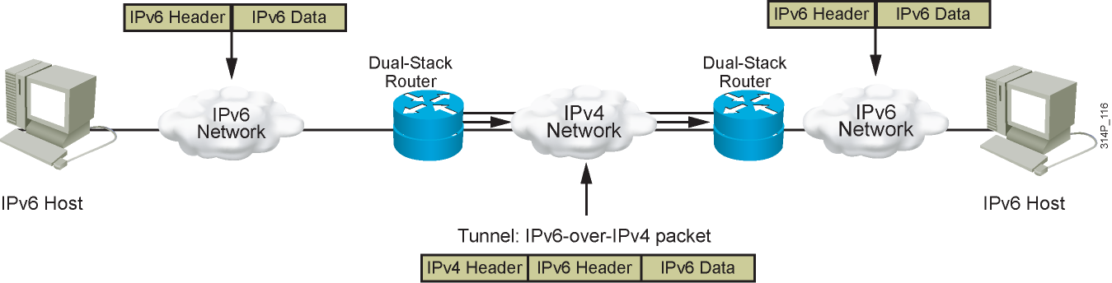
IPv6 Tunneling
Tunneling is an integration method in which an IPv6 packet is encapsulated within another protocol, such as IPv4. This method of encapsulation is IPv4.
  Includes a 20-byte IPv4 header with no options and an IPv6 header and payload
  Requires dual-stack routers

Slide 24
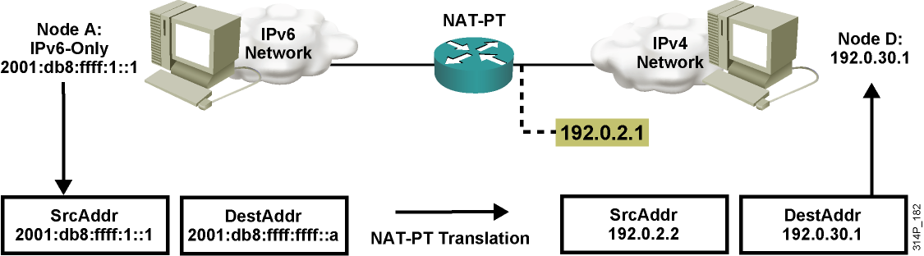
Translation—NAT-PT
NAT-Protocol Translation (NAT-PT) is a translation mechanism that sits between an IPv6 network and an IPv4 network.
The job of the translator is to translate IPv6 packets into IPv4 packets and vice versa.

Slide 25
Enabling IPv6 on Cisco Routers
RouterX(config)#
ipv6 unicast-routing
Enables IPv6 traffic forwarding
RouterX(config-if)#
ipv6 address ipv6prefix/prefix-length eui-64
Configures the interface IPv6 addresses
Notes:
There are two basic steps to activate IPv6 on a router. First, IPv6 traffic forwarding must be activated, then each interface where IPv6 is required must be configured.
By default, IPv6 traffic forwarding is disabled on a Cisco router. To activate IPv6 traffic forwarding between interfaces, the global command ipv6 unicast-routing must be configured. This enables the forwarding of unicast IPv6 traffic.
IPv6 is enabled on a per interface basis.
Configuring an IPv6 address on an interface automatically configures the interface link-local address and activates IPv6 for that interface.

Slide 26
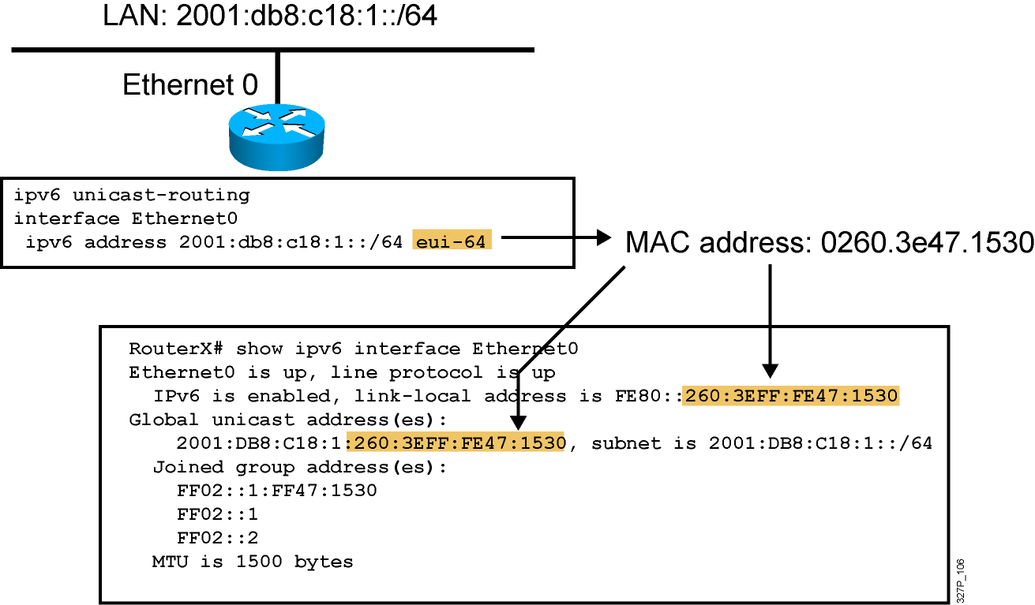
IPv6 Address Configuration Example
Notes:
240, 197, 102
The configuration of the IPv6 address on an interface automatically configures the link-local address for that interface. Also, the interface automatically joins the required multicast groups for that link:
Solicited node multicast address FF02::1:FF47:1530
All hosts on the link multicast addresses FF02::1
All routers on the link multicast addresses FF02::2
The solicited node multicast address is used in the duplicate address detection algorithm and neighbor discovery.
A solicited node multicast address is joined for each IPv6 unicast and anycast address configured on the interface.

Slide 27
Configuring Static route for IPv6
RouterX(config)#ipv6 unicast-routing
RouterX(config)#ipv6 route prefix/prefix-
length [ip next-hop|output interface]

Slide 28
Configuring and Verifying RIPng for IPv6
RouterX(config)#
ipv6 router rip tag
Creates and enters RIP router configuration mode
RouterX(config-if)#
ipv6 rip tag enable
Configures RIP on an interface
show ipv6 rip
Displays the status of the various RIP processes
show ipv6 route rip
Shows RIP routes in the IPv6 route table
Notes:
This is a sample of the syntax of some commonly used commands. The syntax is similar, if not identical, to their IPv4 counterparts.
Enabling RIP on an interface will dynamically create a « router rip » process if necessary

Slide 29
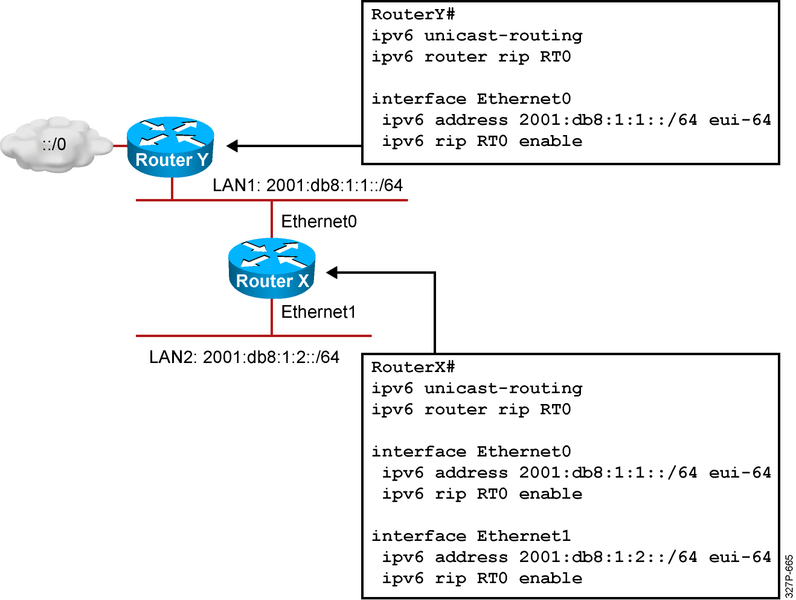
RIPng for IPv6 Configuration Example
Notes:
The example shows a two router portion of a larger network. The lower router is connected to two internal LANs. The screen text is from the lower router, called Router1. It shows that RIP is enabled on both Ethernet interfaces (ipv6 rip RT0 enable).

Slide 30
Configuring OSPFv3 in Cisco IOS Software
  Similar to OSPFv2
    Prefixes existing interface and EXEC mode commands with “ipv6”
  Interfaces configured directly
    Replaces network command
  “Native” IPv6 router mode
    Not a submode of router ospf command

Slide 31
Enabling OSPFv3 Globally
ipv6 unicast-routing
!
ipv6 router ospf 1
router-id 2.2.2.2

Slide 32
Enabling OSPFv3 on an Interface
interface Ethernet0/0
ipv6 address 3FFE:FFFF:1::1/64
ipv6 ospf 1 area 0

Slide 33
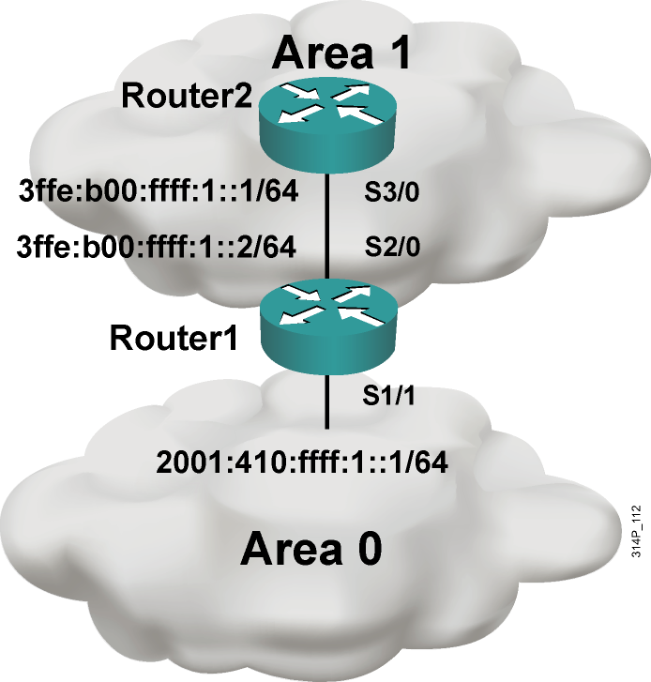
OSPFv3 Configuration Example
Router1#
interface S1/1
ipv6 address 2001:410:FFFF:1::1/64
ipv6 ospf 100 area 0
interface S2/0
ipv6 address 3FFE:B00:FFFF:1::2/64
ipv6 ospf 100 area 1
ipv6 router ospf 100
router-id 10.1.1.3
Router2#
interface S3/0
ipv6 address 3FFE:B00:FFFF:1::1/64
ipv6 ospf 100 area 1
ipv6 router ospf 100
router-id 10.1.1.4

Slide 34
Configuring EIGRPv6 for IPv6
RouterX(config)#ipv6 unicast-routing
RouterX(config)#ipv6 router eigrp AS
RouterX(config-router)#eigrp router-id id
RouterX(config-router)#no shutdown
RouterX(config)#interface interface-id
RouterX(config-if)#ipv6 eigrp AS

Slide 35
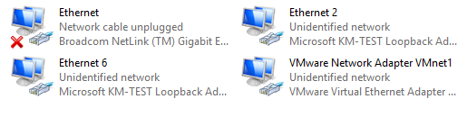
IPv6 on Windows XP
C:\> netsh interface ipv6 install
C:\> netsh
netsh> interface ipv6
netsh interface ipv6> add address “Ethernet 2” 2009::1
netsh interface ipv6> delete address “Ethernet 2” 2009::1
netsh interface ipv6> show address
C:\>

Slide 36
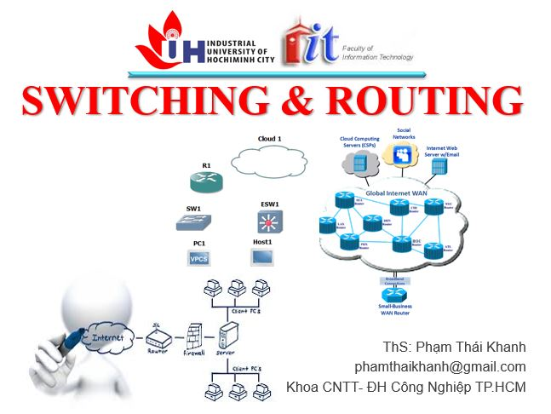


phamthaikhanh@gmail.com
This Photo by Unknown Author is licensed under CC BY-NC

